Slide 1
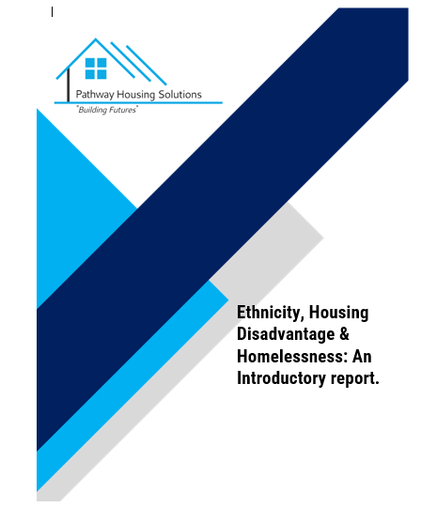



HIDDEN VOICES: Phase 1
Research on Racial Inequality Housing & Homelessness:
Henri Baptiste Pathway Housing Solutions
Dr Nick Clare University of Nottingham

Slide 2
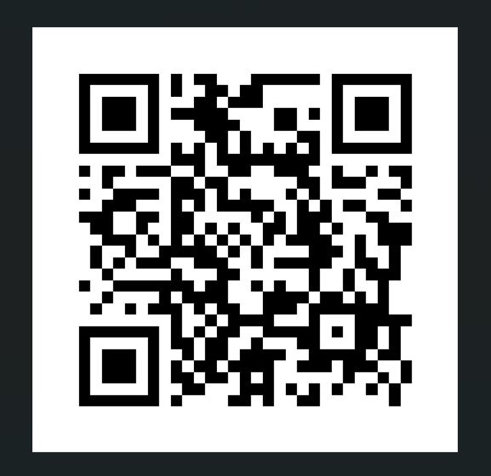
Tackling Race Inequality

Slide 3

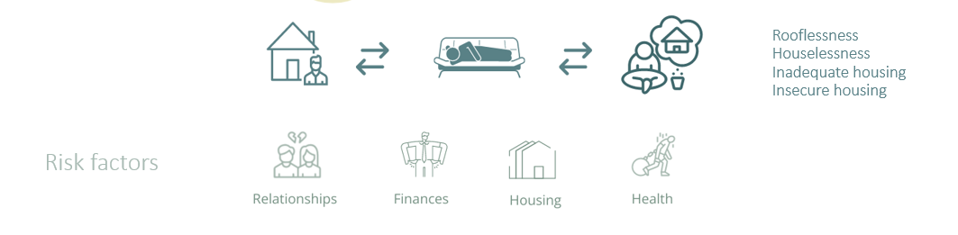
Definitions and Types of homelessness
CONTEXT
‘Core homelessness’: the most severe and immediate forms of homelessness (e.g. rough sleeping, living in homeless hostels/shelters)
Statutory homelessness, based on relevant legislation (i.e. applied to a local authority and eligible and homeless (or threatened with homelessness in the near future))
Hidden homelessness, i.e. people effectively homeless but neither visible nor (often) in official homelessness stats – e.g. severe overcrowding, concealed or sharing, sofa surfing
At risk of homelessness in near future, - e.g. insecure tenure and or financial difficulties
Homelessness Pathways

Slide 4
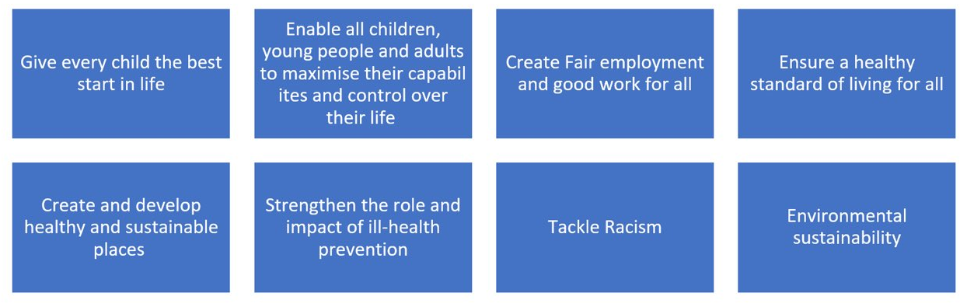
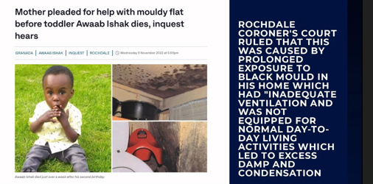
Racial discrimination is recognised as one of the 8 domains in Sir Michael Marmot’s social determinants of health
Notes:
SOPHIE
Brief background: People experiencing homelessness face some of the most severe inequalities in their physical and mental health compared to the rest of society, with difficulties accessing healthcare when they need it. They’re more at risk of long-term physical health problems (63% compared to 22%), and more likely to be diagnosed with a mental health problem (82% compared to 12%*). ⁻ Homeless Link, The Unhealthy State of Homelessness, 2022 Unhealthy_State_of_Homelessness_2022.pdf (kxcdn.com)
This is compounded by experiencing racism…
Broader public health agenda addressing the impact of racism and discrimination on health.

Slide 5

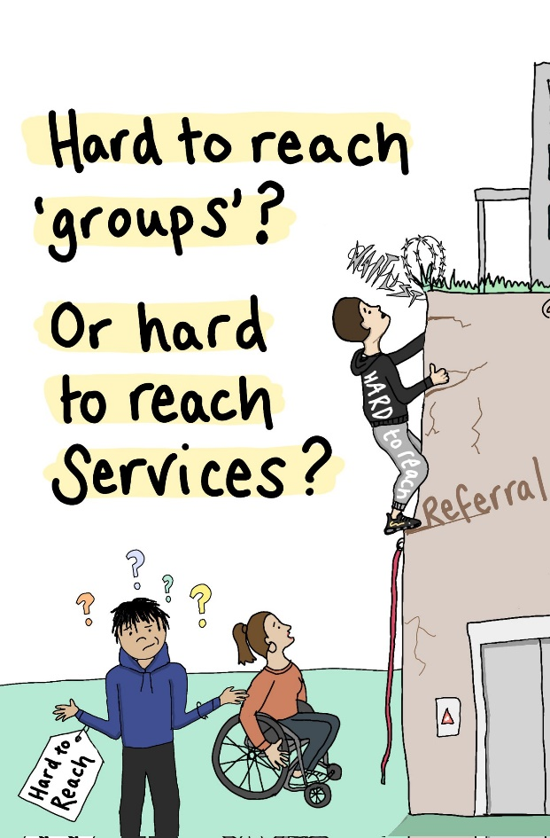

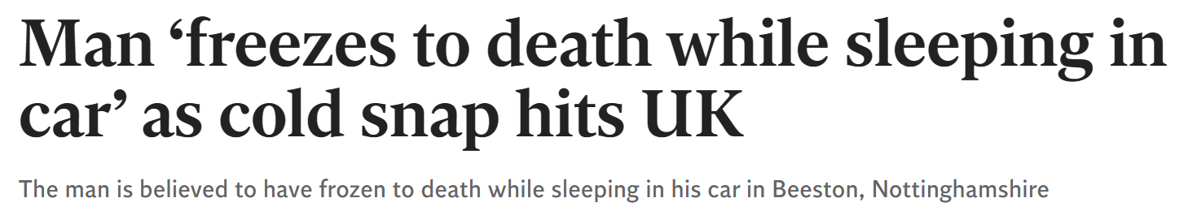
Homelessness Has Another Face
Easy To Ignore!

Slide 6

Four decades of struggle by BAME communities, bolstered by legislation, and statutory & regulatory codes from the 1960s onwards, have failed to confront adequately and systematically, racial disadvantage and discrimination in housing…Shelter
Racism not only happens at an interpersonal level, but also at a systemic level.
Institutional Discrimination
“The collective failure of an organisation to provide an appropriate and professional service to people because of their colour, culture, or ethnic origin. It can be seen or detected in processes, attitudes and behaviour which amount to discrimination through unwitting prejudice, ignorance, thoughtlessness and racist stereotyping which disadvantage minority ethnic people”.

Slide 7
RESEARCH AIMS & OBJECTIVES
1. Explore and seek to explain the barriers that black and minority ethnic communities encounter in housing and homeless service provision.
2. Review existing policy, practice and literature, and data collection methods
3. Consider the potential benefits of alternative models of housing supply, and homelessness service provision
4. Explore good practice and ways in which barriers can be overcome.
5. Use a series of community listening events, action learning and primary research techniques to engage with hidden homeless, policymakers, funders, stakeholder organisations and decision-makers,
6. Make recommendations for policy and practice at local, regional and national levels.
“It is only once the barriers and challenges are properly understood, that any attempt can be made to tackle them”.
The research provides a focus to ask…why is race still affecting people’s housing options in the 21st century.

Slide 8
RATIONALE – SOLUTION FOCUSSED
Ethnicity, Housing Disadvantage, and Homelessness
Hidden Homelessness
Alernative Housing Options
Housing Led Interventions
Choice Based Lettings
Homelessness Service Access
Homelessness Reduction Act
Fig : Research Themes:- Four key, yet underacknowledged, sites of structural discrimination with regard to housing and homelessness (BLUE), as well as two strategic sites of intervention to combat this and address housing need (GREEN).
Our research points to ways in which the policy framework leads to exclusion from support and perpetuates disproportionate levels of homelessness among racialised minorities

Slide 9


Slide 10
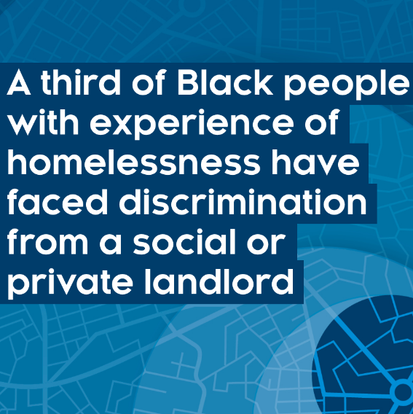
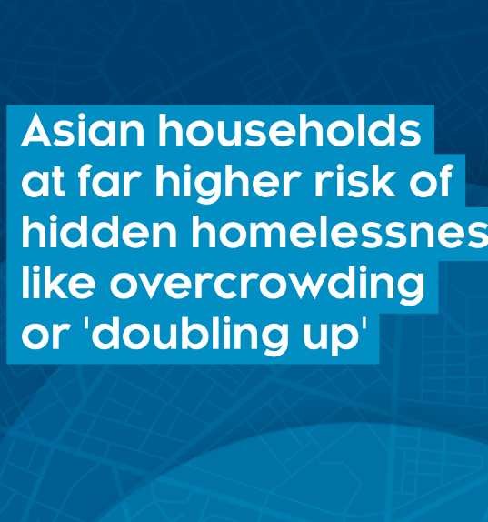
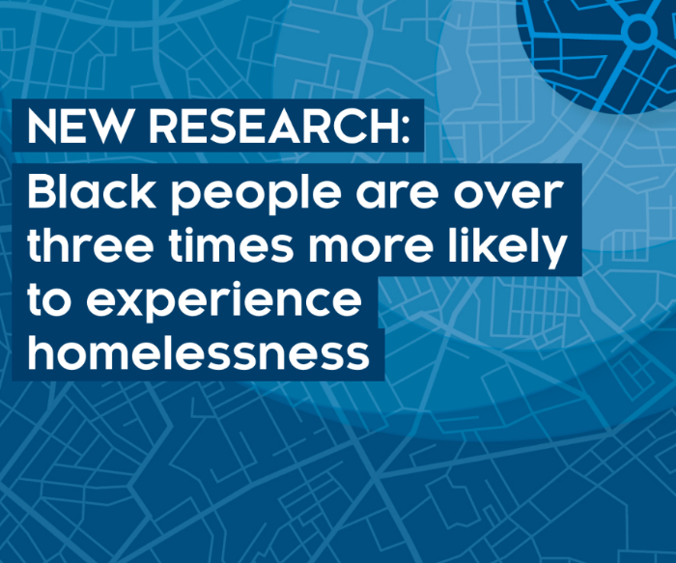
WHAT WE KNOW

Slide 11
Percentage of Homeless Households, Ethnicity Over Time

Slide 12
Links between experience of racial or ethnic discrimination and exposure to homelessness - a social or private landlord.
One third of Black people with experience of homelessness, report discrimination from a social or private landlord.
May indicate that experiences of discrimination drive heightened exposure to homelessness and/or that those who are homeless are exposed to higher levels of discriminatory behaviour.
Notes:
Some new evidence from 2 surveys on reported experiences of discrimination
- EHS, specifically re housing/landlords
- UKHLS, broader range of bases of discrimination
Also earlier evidence from Poverty & Social Exclusion Survey
Shows substantial % of BAME groups report discrimination, and much more so those reporting homelessness
PSE highlighted harassment, also Stop & Search policing
Statistical models show sig relationship from reported discrimination to higher homeless risk

Slide 13
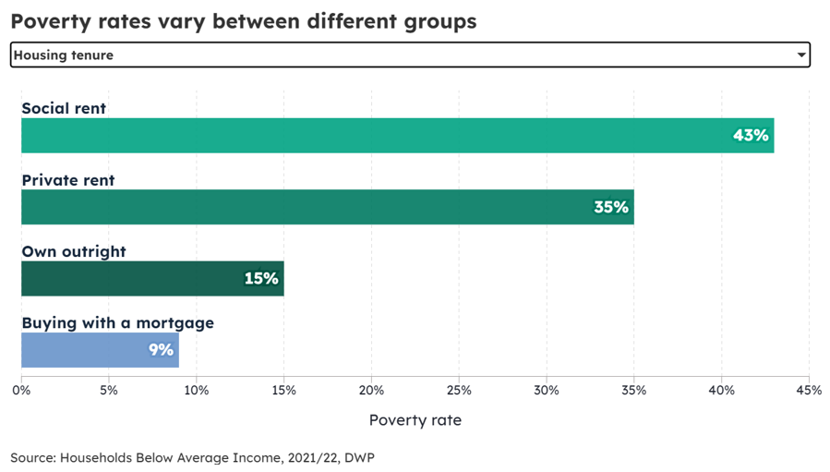
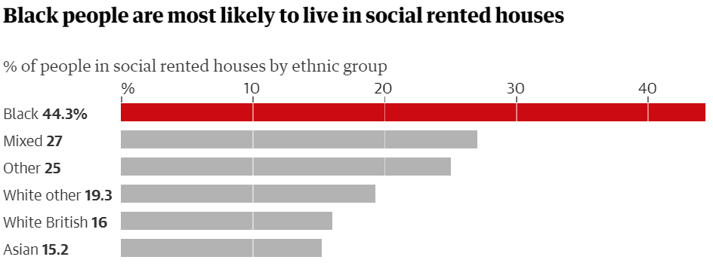
Social Housing & Poverty

Slide 14
Statutory homelessness in England 2020 AND OOA
And this message is reinforced when we look at statutory homelessness
There is a consistent pattern, whereby Black, Other and Mixed groups have much higher rates than White
OOA - LAs using OOA housing for homeless households who are owed a duty – increasing (91% in 22/23)
92% of LAs disproportionately placed black households OOA
‘OOA’25% did not provide data
33% of LAs who id not provide ethnicity info in their response stated that they did not record this data
Notes:
Some new evidence from 2 surveys on reported experiences of discrimination
- EHS, specifically re housing/landlords
- UKHLS, broader range of bases of discrimination
Also earlier evidence from Poverty & Social Exclusion Survey
Shows substantial % of BAME groups report discrimination, and much more so those reporting homelessness
PSE highlighted harassment, also Stop & Search policing
Statistical models show sig relationship from reported discrimination to higher homeless risk

Slide 15
Percentage of UK households that are overcrowded by ethnicity.

Slide 16
SUMMARY OF KEY FINDINGS A
The category ‘BAME’ can obscure as much as it reveals, with significant and important variations between different ethnic groups.
Despite research showing that racialised minorities are overrepresented in their experiences of housing disadvantage and homelessness, due to methodological limitations this is likely to be an underestimation of the true situation.
Racialised minorities suffer housing discrimination in both the private rented (PRS) and social housing sectors.
Black and Minority Ethnic (BAME) housing associations play a vital role in supporting the housing needs of racialised minorities but are struggling in the current funding landscape. Innovative partnership models are therefore urgently needed.
Forms of hidden homelessness are especially prevalent among racialised minorities, leading to significant evidence and policy gaps. There is thus a need to move beyond the data with detailed, longitudinal qualitative research into this phenomenon.

Slide 17
SUMMARY OF KEY FINDINGS B
Dwindling supply of Council housing and accessibility to housing association property, coupled with the unviability of the PRS, BAME population growth, and increasing demand for affordable housing, requires innovative partnership models between the public, private and third sector. More work is urgently needed in in this area.
Services are struggling to reach or meet the needs of racialised minority groups. Commissioning bodies should consider contracting arrangements that deliver culturally competent, anti-racist services that engage with these groups and with existing support services
Focus on Rough Sleepers obscures needs of other homeless groups. Can embed structural discrimination in policy and service delivery
Co-production with community groups and those with lived experience is vital in attempts to reduce housing disadvantage & experiences of homelessness among racialised minorities

Slide 18

What More Can The Housing Sector Do - Gift & Will!
Housing pathways between supported housing and general needs. Embed a race lens in housing and homelessness services
Cohesive housing & homelessness services.…
Allocations and Tenancy Sustainment…
Leadership & Representation…
New Housing Delivery Partnership Models
Asset Management Plans…
Support - existing tenants & those not engaging. Audit of lettings and evictions. Review Council nominations and adopt local freedoms/flexibilities.
Embed Race in NHF and CiH Strategies. Culturally competent training* HfC aspirations or targets. HfC focus on race rather than grouping with EDI commitments. Mandate % of HA surplus – redistributed to most at risk. Ring-fence AHP. EIA (PSED).
Ethical disposal of street properties - Loc(HA)L Homes campaign.
Third Sector Housing Providers including Community Led Housing as an option . Small infill sites, Percentage of new build on large schemes/regeneration. s106 Homes
* To improve understanding of specific needs of communities

Slide 19

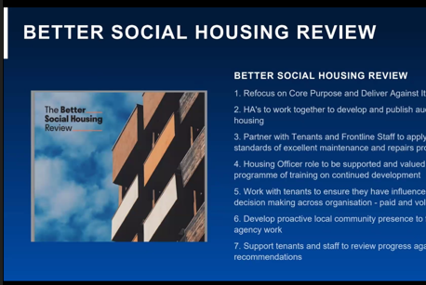
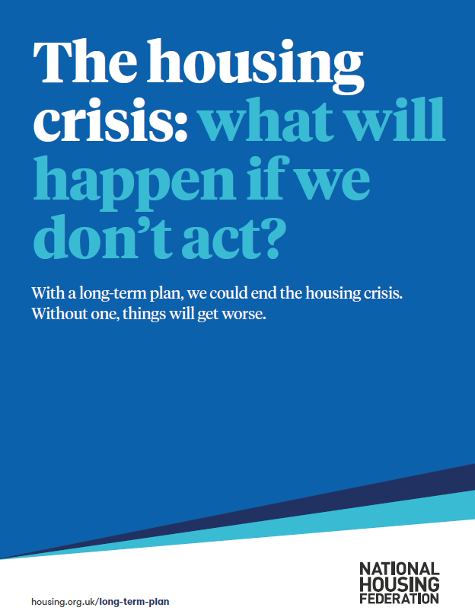

What More Can The Housing Sector Do – Gift & Will!

Slide 20
“There is a lot of black people that are homeless, But because we live as our community…we're able to bounce around through friends and family, and have places to stay…So…you don't see many of us sleeping rough, but that doesn't mean that we're not homeless. We've still got nowhere to go…But it's not highlighted in any way.”
Angela
“There's not really much out there for the black person...You go into certain [organisations] and they're not understanding our needs, the way we talk, our actions, not understanding because they're not black themselves. But there's no black organisations that you can go to or phone up.” - Clive

Slide 21
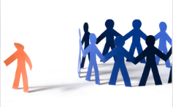
Henri
henri@pathwayhousingsolutions.org.uk
Notes:
SOPHIE AND MICHAEL
If you would like to talk more about anything that was discussed today, please feel free to reach out via email.

